Slide 1
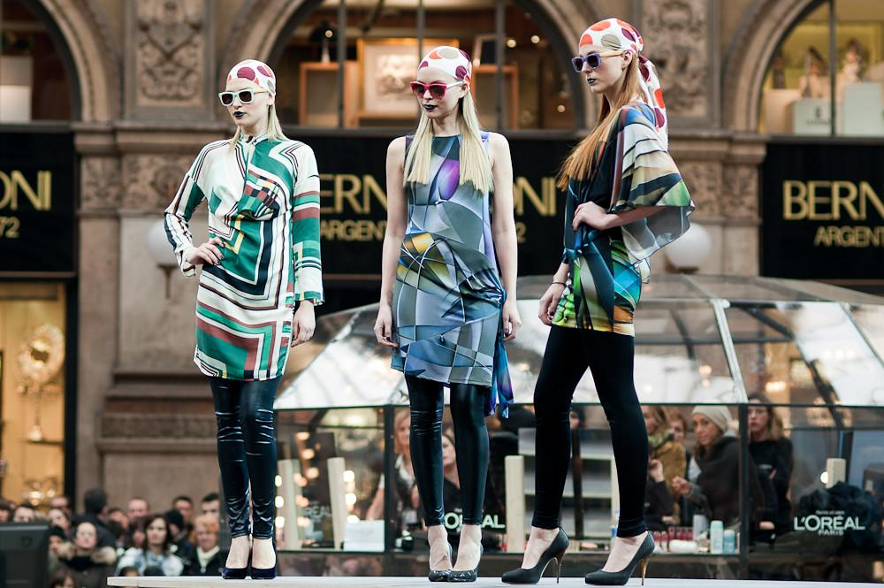
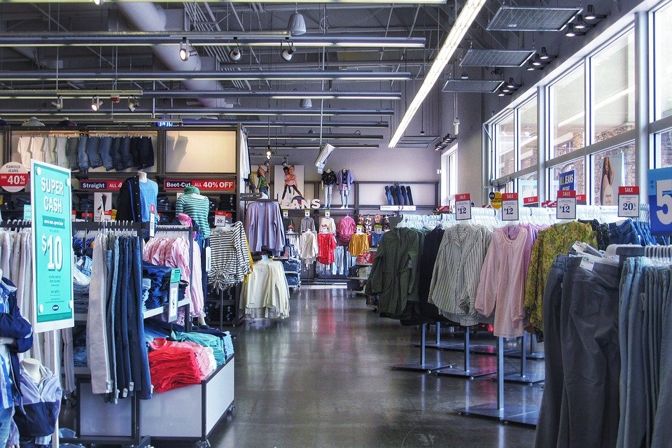
Capstone Project- Fashion Shops in Milan

Slide 2
1. DESCRIPTION OF THE PROBLEM AND DISCUSSION OF THE BACKGROUND
A. INTRODUCTION / BUSINESS PROBLEM:
ANALYSIS OF DATA VENUES IN MILAN FOR THE FASHION INDUSTRY
Milan, in Italian, Milano, is a city in northern Italy
The city proper has a population of about 1.4 million while its metropolitan city has 3.26 million inhabitants.

Slide 3
Target Audience: Stakeholders for Fashion Shops
The city has been recognized as one of the world's four fashion capitals thanks to several international events and fairs, including Milan Fashion Week and the Milan Furniture Fair, which are currently among the world's biggest in terms of revenue, visitors and growth.

Slide 4
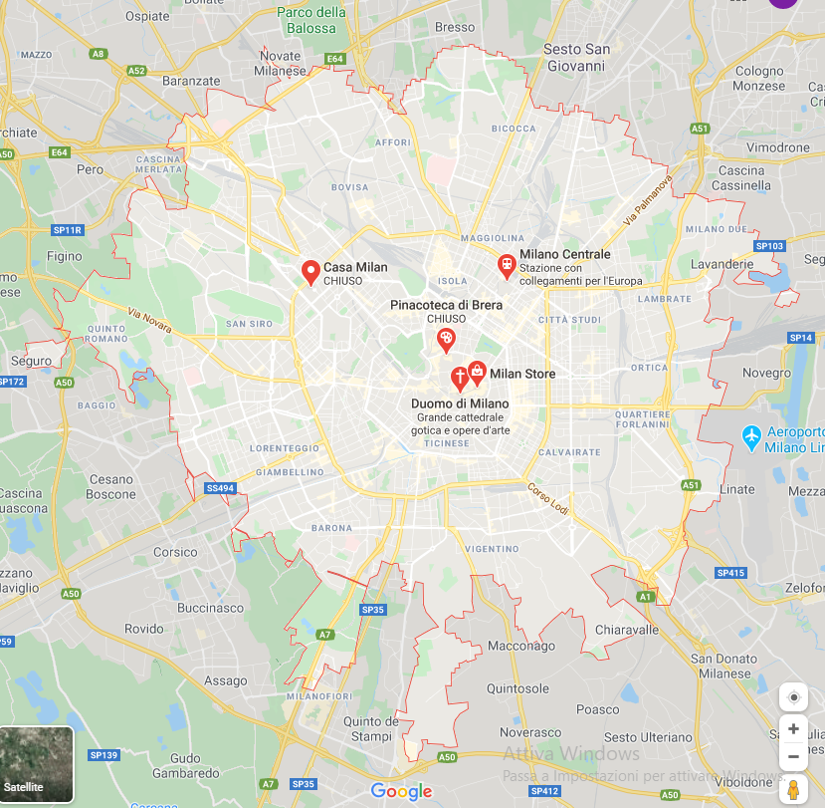
Map of the City of Milan
It is a continuously built-up urban area, that stretches well beyond the boundaries of the administrative metropolitan city, is the fourth largest in the EU with 5.27 million inhabitants.
The population within the wider Milan metropolitan area, also known as Greater Milan, is estimated at 8.2 million, making it by far the largest metropolitan area in Italy and the 4th largest in the EU.

Slide 5
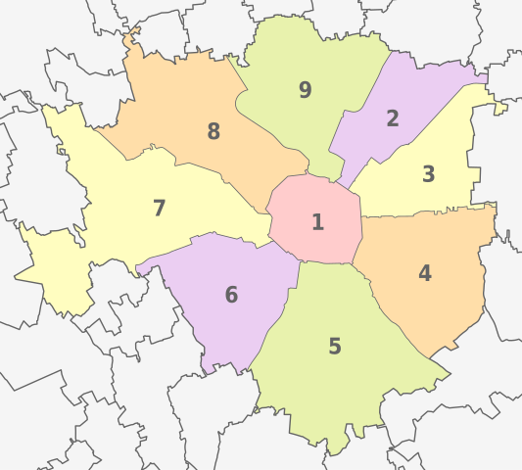
SOURCE AND DESCRIPTION OF THE DATA
Milan has nine (09) official Boroughs (in Italian, Municipi), numbered from 1 to 9, that is Borough 1, Borough 2, etc.
The province of Milan covers an area of about 181.76 km2.

Slide 6
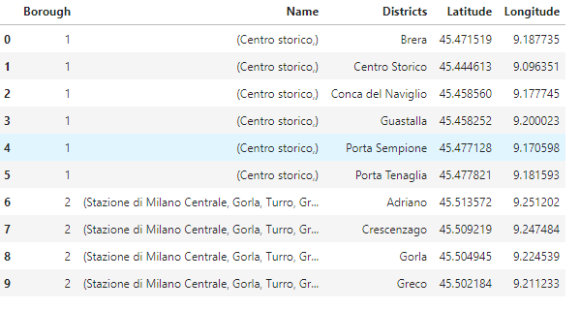
Dataframe of Milan, District and Boroughs
Milan has geographical coordinates with latitude 45.4668 and longitude 9.1905.
As of 2014, Milan had 145 districts

Slide 7
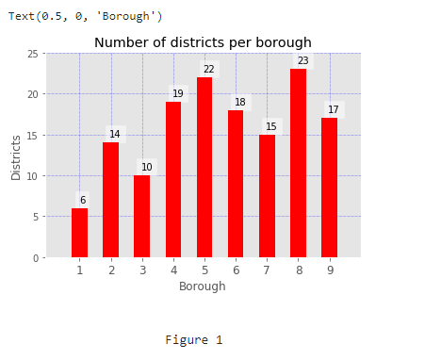
Bar Chart of Milan’s Boroughs and the Number of Districts per Borough
Borough 1 - 6 Districts
Borough 2 - 14 Districts
Borough 3 - 10 Districts
Borough 4 - 19 Districts
Borough 5 - 22 Districts
Borough 6 - 18 Districts
Borough 7 - 15 Districts
Borough 8 - 23 Districts
Borough 9 - 17 Districts

Slide 8
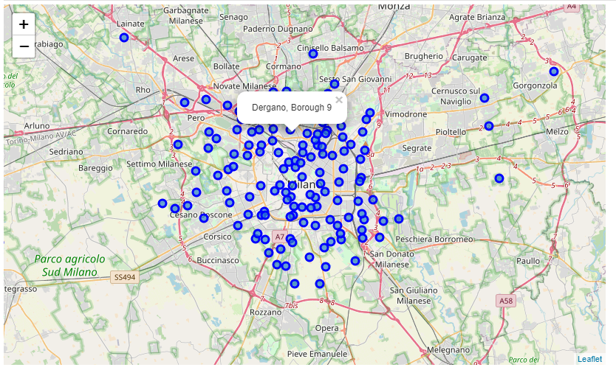
Map of Milan and its Districts
The geographical positions of the districts on the map are represented by the blue circles. Dergano is a district found in Borough 9.

Slide 9
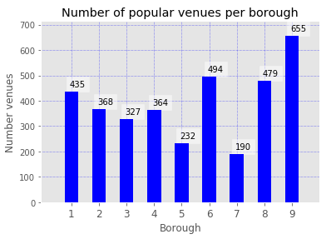
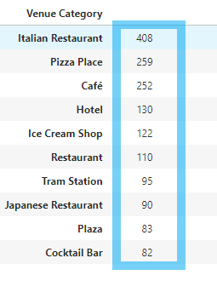
With Foursquare API, a total of 3682 venues were returned with 290 distinct venue categories.
Below, we see as highlighted that the majority of popular venue categories consists of Italian Restaurants, Cafés, Pizza Places, Hotels and Ice Cream Shops, etc. Also, we have shops and stores that we will take into consideration, since that is our focus: popularity in terms of well-known boroughs and districts, that also have a large number of stores and shops.
Most popular venue categories

Slide 10
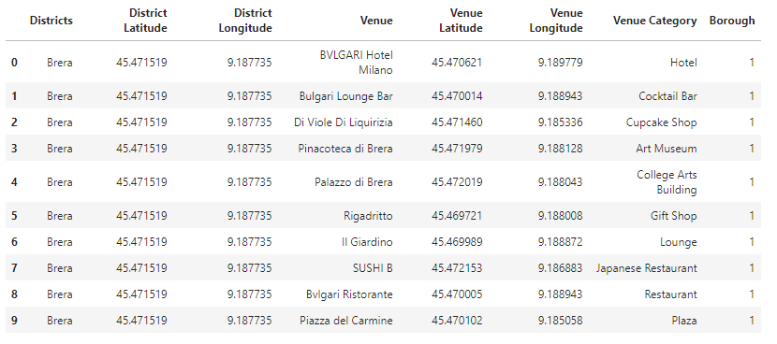
Venues, their categories and their geographical coordinates

Slide 11
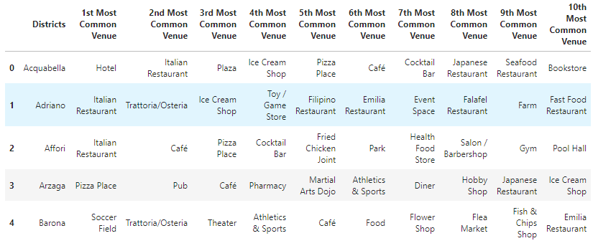
In view of clustering, taking into consideration the 10 most common venues for each district.
Hence, the dataset showing the first few districts and their 10 top venues

Slide 12
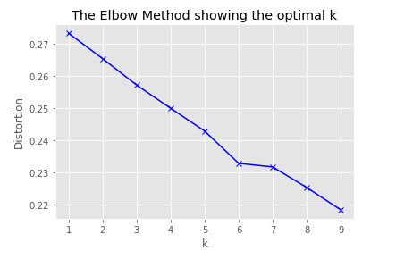
The Elbow Method
k=6
K-means clustering from Scikit Learn is an unsupervised machine learning method of vector quantization, originally from signal processing, that aims to partition n observations into k clusters in which each observation belongs to the cluster with the nearest mean (cluster centers or cluster centroid), serving as a prototype of the cluster. It is popular for cluster analysis in data mining.

Slide 13
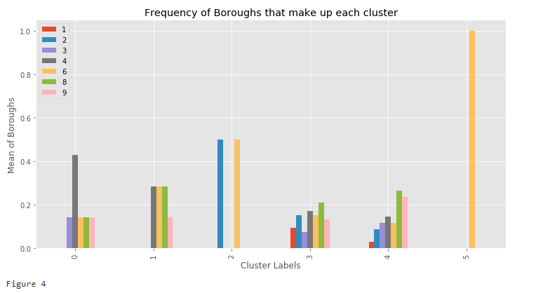
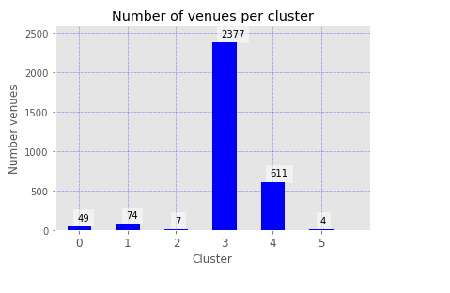
For k=6, we have 6 clusters
1st graph shows the mean of each borough per cluster, which signifies the quantity, like the measurement of each ingredient to make up a cake. The cake in this case is the cluster.
For example, for cluster label 5, it has 4 venues, of which the 2nd graph shows as venues belonging only to Borough 6, the orange bar as explained in the legend on the top left corner of the first graph.
So, cluster 5 is made up of only one borough.
Clusters 0, 1, 2 and 5: low popularity, with 49, 74, 7 and 4. We drop them and focus on clusters 3 and 4.

Slide 14
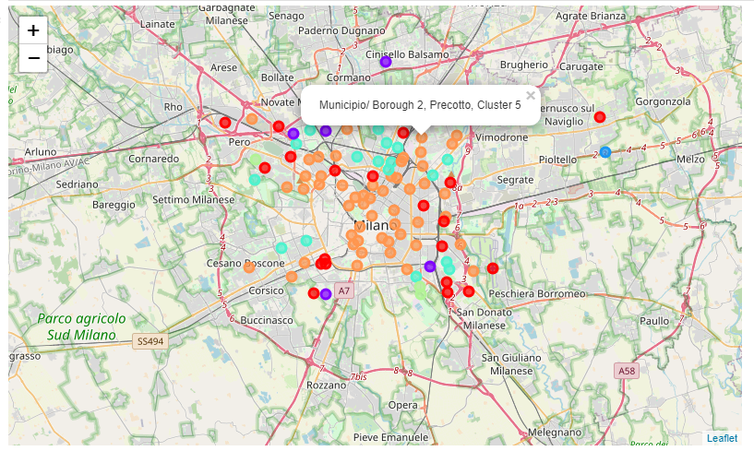
Visualization of Clusters on a Folium Map
Color circles represent different clusters

Slide 15
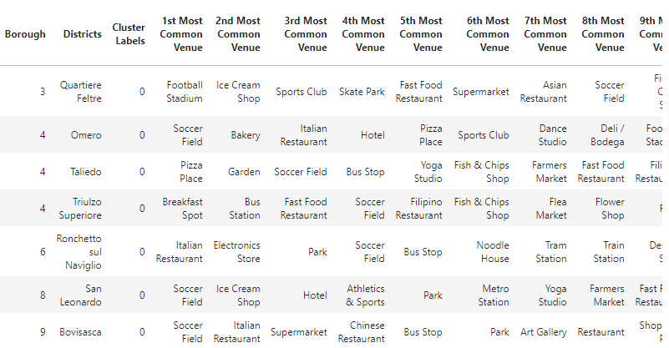
Dataframe of Cluster 0

Slide 16
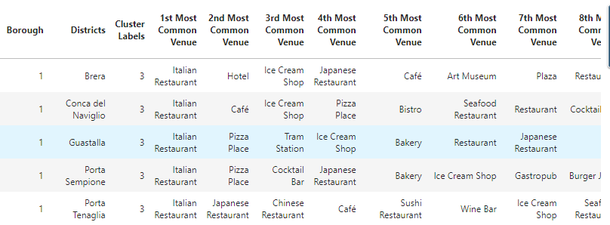
Dataframe of Cluster 3

Slide 17
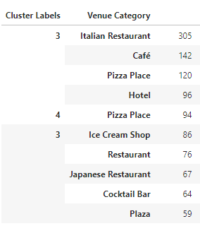
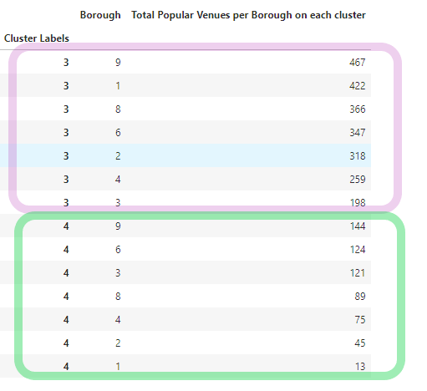
Popularity of venue categories according to the clusters, sorted according to number of venues per category, for example, cluster 3 has 305 restaurants, 142 cafés, etc.
Boroughs 1, 6, 8 and 9 have very high popularity

Slide 18
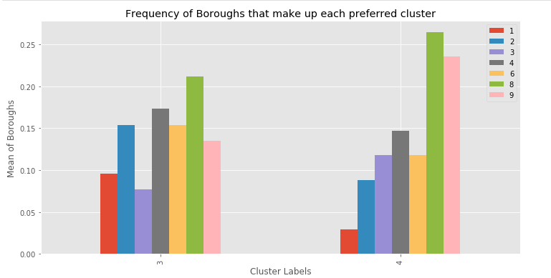
Frequency of Boroughs that make up each of the Preferred Clusters
Borough 8 has the highest popularity for both clusters, followed by 9

Slide 19
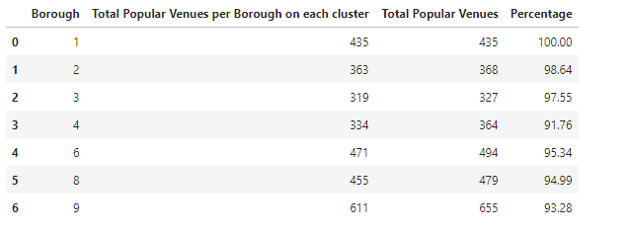
Percentage of each Borough found in the Preferred Clusters
All of Borough 1 is found in both clusters (100%), 98% of Borough 2 and so on.

Slide 20
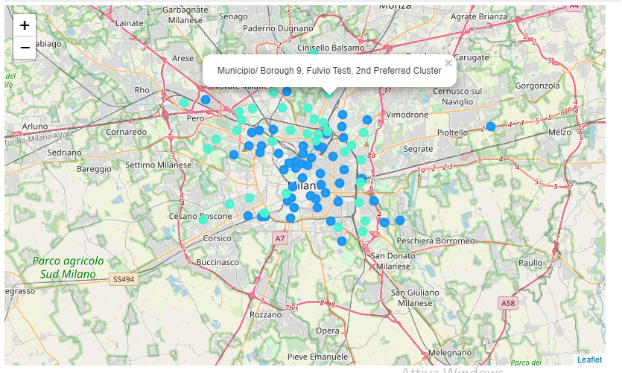
Map of the 2 Preferred Clusters (3 and 4)

Slide 21
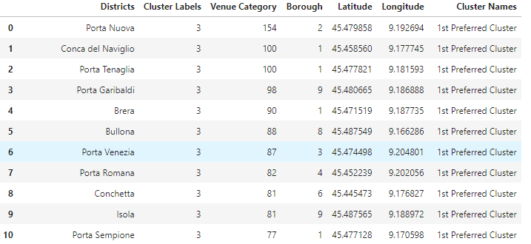
Popular Districts for each Cluster:
Popular districts in Cluster 3

Slide 22
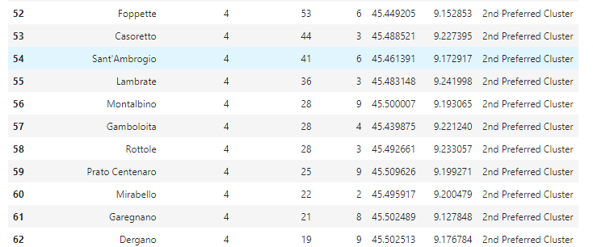
Popular Districts for each Cluster:
Popular districts in Cluster 4

Slide 23
Selected Top 3 Boroughs:
Borough 1 is a perfect candidate for the business
Borough 9 comes next and finally,
Borough 8 is 3rd preferred.

Slide 24
Observations
Venue popularity is based on information retrieved from Foursquare
Can be biased in some cases. Popular places are known based on reviews which means if a venue is not reviewed and is still popular, it may not appear in our data.
Foursquare updates regularly
Research is accurate, though results for districts could alter because data collected is real-time based.

Slide 25
Recommendations
It is important that after such studies, stakeholders should visit Ground 0 to have a better view and understanding about the districts.

Slide 26
CONCLUSION
I strongly believe that my work would be very helpful for Fashion start up businesses targeting Milan, especially with the millions of tourists that visit the city regularly.

Slide 27
Municipalities of Milan, Wikipedia
Foursquare API
Geoportale Commune Milano
REFERENCES

